Slide 1
Lecture 5: Simple spatial models for coastlines
March 29, 2015

Slide 2
Why might we care about 1D spatial models?
Coastlines
Distances towards/away from an experiment
Introduction to other 1D models…

Slide 3
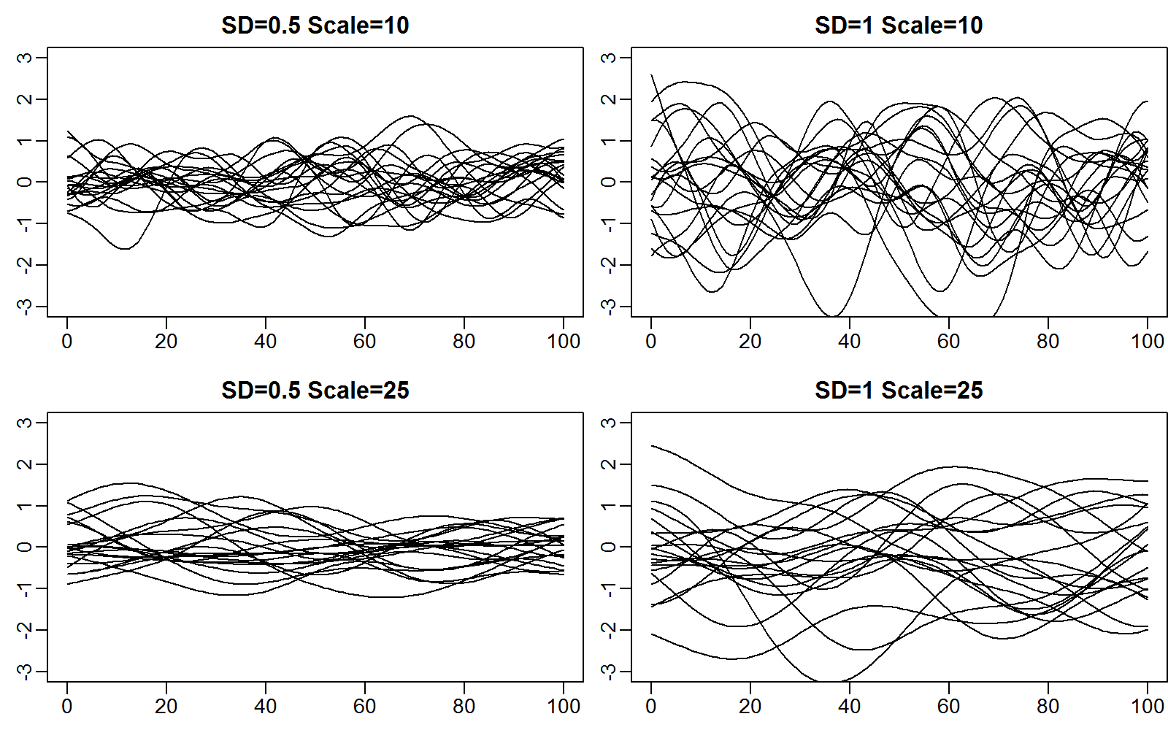

Gaussian process
$$ℰ\sim GP(0,𝒞)$$

Slide 4


Gaussian process
$$ℰ\sim GP(0,𝒞)$$
Then…
$$ε\sim MVN(0,Σ)$$
Surplus production
Spawning biomass relative to unfished equilibrium

Slide 5

Coastline (sites are blue circles)
Imagine that:
$$c_{s}\left(i\right)\sim g\left(μ_{s}\right)$$
Where $c_{s}(i)$ is a count sample for site s and replicate i
where g is the observation distribution and $μ_{s}$ is the expected value
You have three density samples per site
Strategies:
Blocking (fixed or random)
Equal-distance autoregression
Unequal-distance autoregression

Slide 6

Blocking (random):
$$c_{s}(i)\sim g(μ_{s})$$
$$μ_{s}=Xβ+ε_{s}$$
$$ε_{s}\sim Normal(0,σ_{ε}^{2})$$
where $σ_{ε}^{2}$ is the random variance
Review properties:
$$E\left(ε_{s}\right)=0$$
$$Var\left(ε_{s}\right)=σ_{ε}^{2}$$
$$Cov\left(ε_{s},ε_{s+d}\right)=0$$

Slide 7

Equal distance autoregression
$$c_{s}(i)\sim g(μ_{s})$$
$$μ_{s}=Xβ+ε_{s}$$
Let’s assume first-order autoregression:
$$ε_{s+1}\sim Normal(ρε_{s},σ_{ε}^{2})$$
We therefore replace distance by ordering

Slide 8
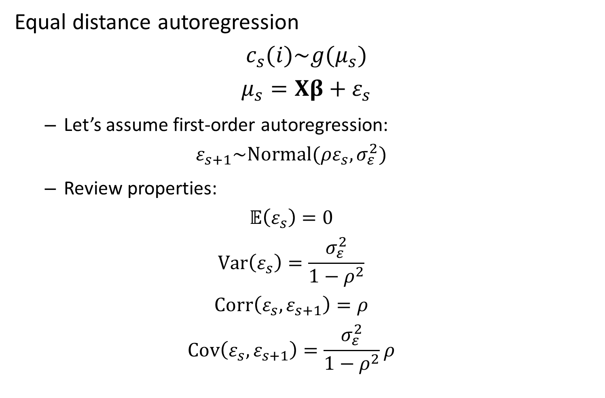
Equal distance autoregression
$$c_{s}(i)\sim g(μ_{s})$$
$$μ_{s}=Xβ+ε_{s}$$
Let’s assume first-order autoregression:
$$ε_{s+1}\sim Normal(ρε_{s},σ_{ε}^{2})$$
Review properties:
$$𝔼\left(ε_{s}\right)=0$$
$$Var\left(ε_{s}\right)=\frac{σ_{ε}^{2}}{1−ρ^{2}}$$
$$Corr\left(ε_{s},ε_{s+1}\right)=ρ$$
$$Cov\left(ε_{s},ε_{s+1}\right)=\frac{σ_{ε}^{2}}{1−ρ^{2}}ρ$$

Slide 9
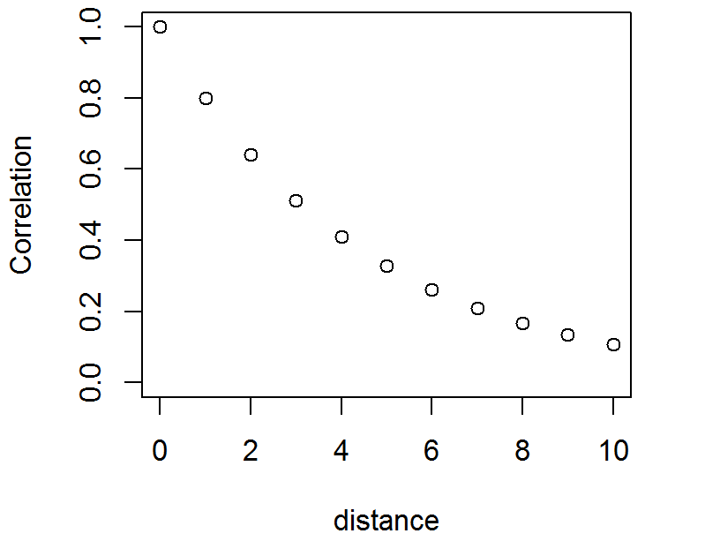

Equal distance autoregression
$$c_{s}(i)\sim g(μ_{s})$$
$$μ_{s}=Xβ+ε_{s}$$
Let’s assume first-order autoregression:
$$ε_{s+1}\sim Normal(ρε_{s},σ_{ε}^{2})$$

Slide 10
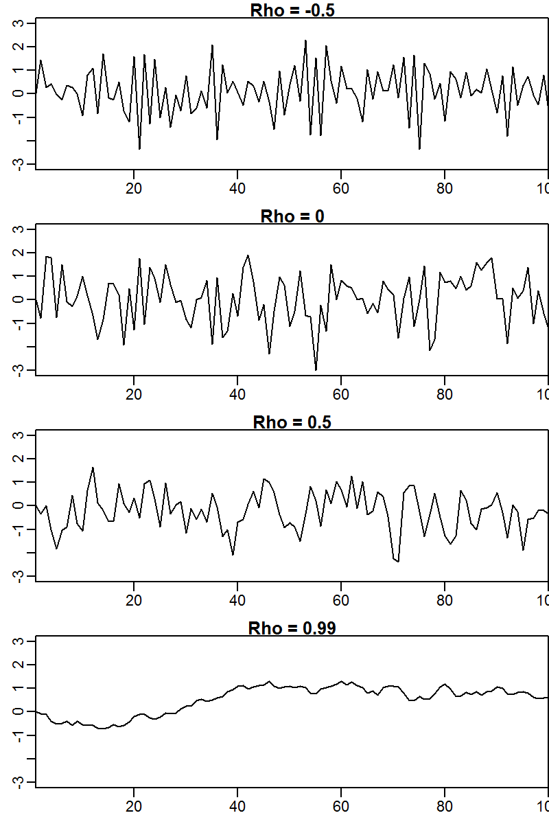
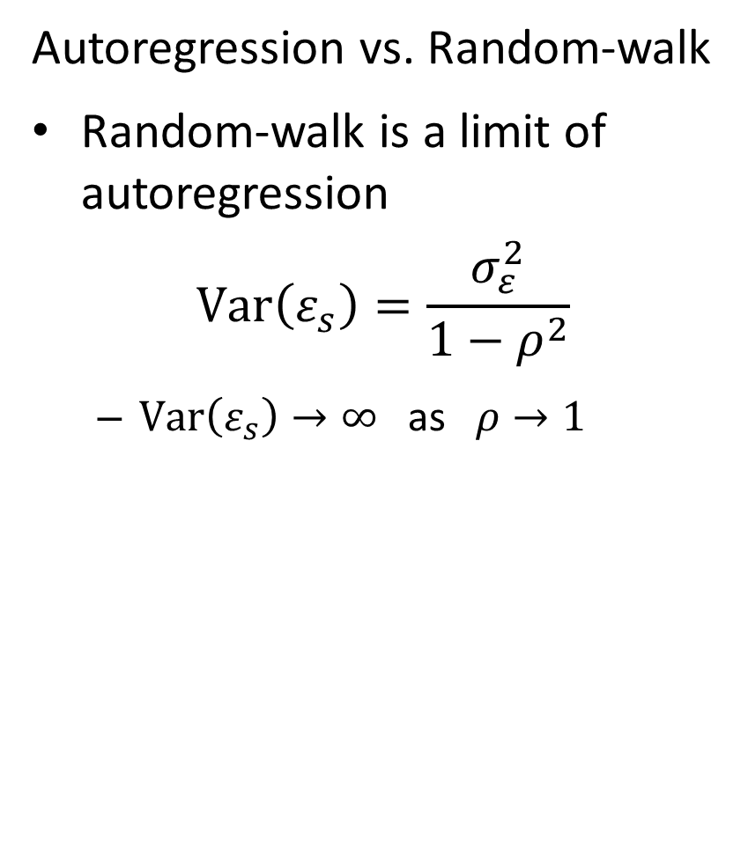
Autoregression vs. Random-walk
Random-walk is a limit of autoregression
$$Var\left(ε_{s}\right)=\frac{σ_{ε}^{2}}{1−ρ^{2}}$$
$Var\left(ε_{s}\right)→∞$ as $ρ→1$

Slide 11

Equal distance autoregression
$$c_{s}(i)\sim g(μ_{s})$$
$$μ_{s}=Xβ+ε_{s}$$
Then…
$$ε\sim MVN(0,Σ)$$
where

Slide 12
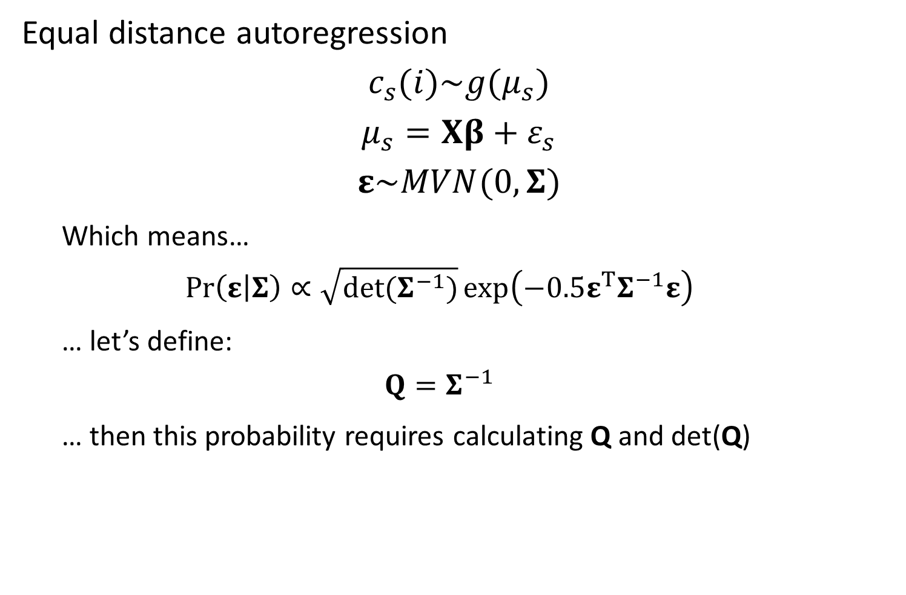
Equal distance autoregression
$$c_{s}(i)\sim g(μ_{s})$$
$$μ_{s}=Xβ+ε_{s}$$
$$ε\sim MVN(0,Σ)$$
Which means…
$$\operatorname{Pr}\left(ε | Σ\right)∝\sqrt{det(Σ^{−1})}\exp\left(−0.5ε^{T}Σ^{−1}ε\right)$$
… let’s define:
$$Q=Σ^{−1}$$
… then this probability requires calculating Q and det(Q)

Slide 13

Equal distance autoregression
$$c_{s}(i)\sim g(μ_{s})$$
$$μ_{s}=Xβ+ε_{s}$$
$$ε\sim MVN(0,Σ)$$
Fortunately its easy to calculate $Q=Σ^{−1}$:

Slide 14
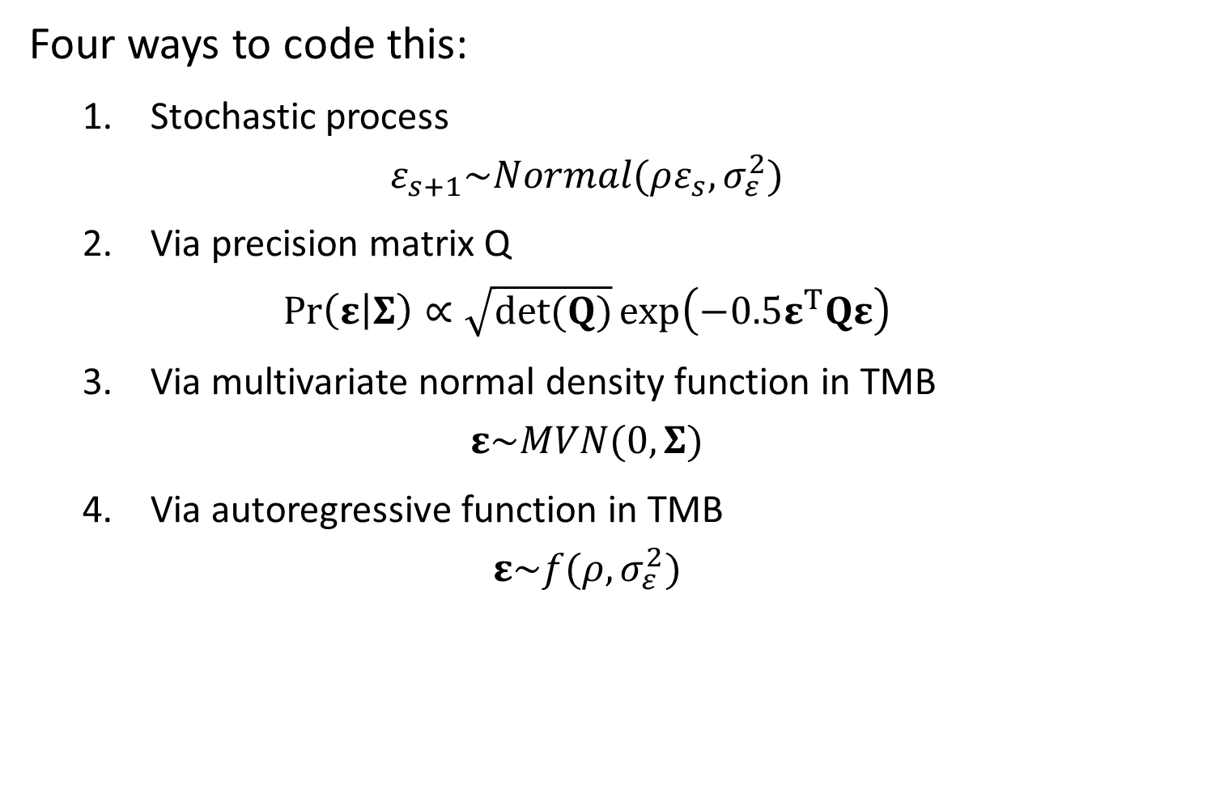
Four ways to code this:
1. Stochastic process
$$ε_{s+1}\sim Normal(ρε_{s},σ_{ε}^{2})$$
2. Via precision matrix Q
$$\operatorname{Pr}\left(ε | Σ\right)∝\sqrt{det(Q)}\exp\left(−0.5ε^{T}Qε\right)$$
3. Via multivariate normal density function in TMB
$$ε\sim MVN(0,Σ)$$
4. Via autoregressive function in TMB
$$ε\sim f(ρ,σ_{ε}^{2})$$

Slide 15
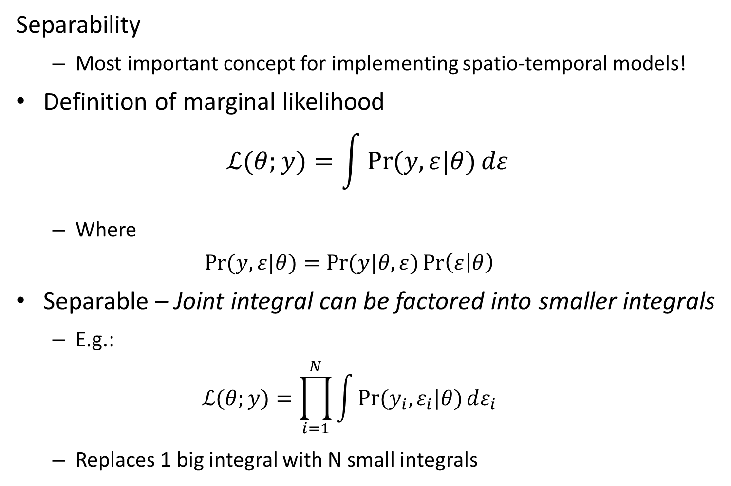
Separability
Most important concept for implementing spatio-temporal models!
Definition of marginal likelihood
$$ℒ(θ;y)=\int{\operatorname{Pr}{(y,ε|θ)}dε}$$
Where
$$\operatorname{Pr}{(y,ε|θ)}=\operatorname{Pr}{(y|θ,ε)}\operatorname{Pr}\left(ε | θ\right)$$
Separable – Joint integral can be factored into smaller integrals
E.g.:
$$ℒ(θ;y)=\prod_{i=1}^{N}{\int{\operatorname{Pr}{(y_{i},ε_{i}|θ)}dε_{i}}}$$
Replaces 1 big integral with N small integrals

Slide 16
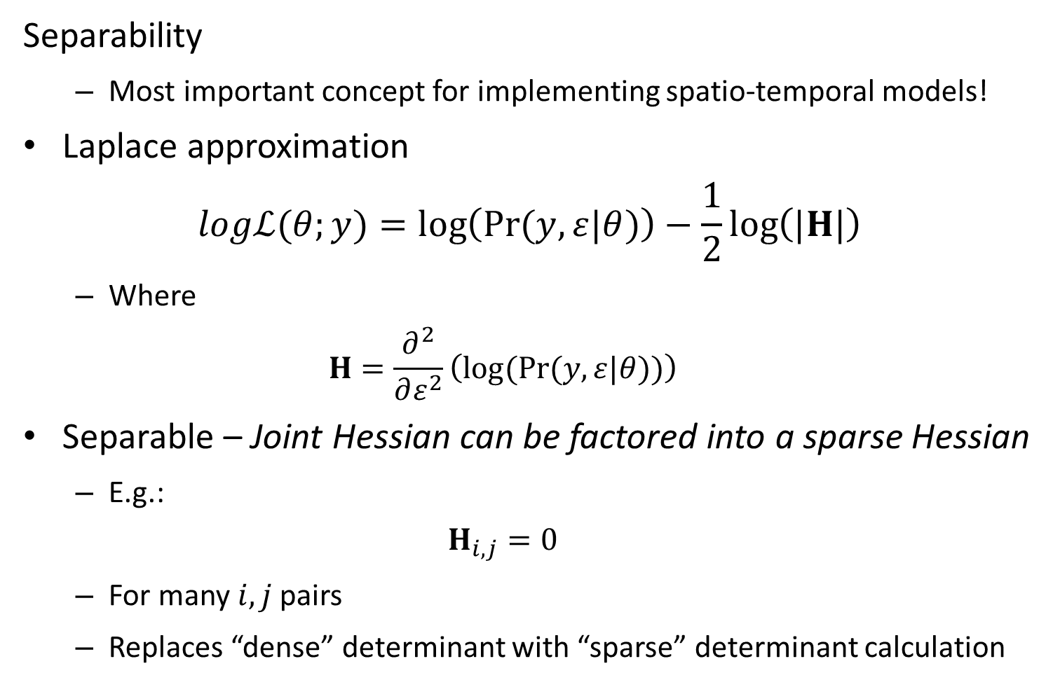
Separability
Most important concept for implementing spatio-temporal models!
Laplace approximation
$$logℒ(θ;y)=\log\left(\operatorname{Pr}{(y,ε|θ)}\right)−\frac{1}{2}\log\left(|H|\right)$$
Where
$$H=\frac{∂^{2}}{∂ε^{2}}\left(log⁡(\operatorname{Pr}{(y,ε|θ)})\right)$$
Separable – Joint Hessian can be factored into a sparse Hessian
E.g.:
$$H_{i,j}=0$$
For many $i,j$pairs
Replaces “dense” determinant with “sparse” determinant calculation

Slide 17
[Show R and TMB code for 4 ways to code this, specifically looking at sparseness of hessian matrix]

Slide 18
Lessons:
Speed
Stochastic process (Version #1) is faster
Often easiest to program stochastic process as well
Why use other versions?
Others are easier to “scale up”
Eventually we’ll use SEPERABLE() to admix different processes
Others may be faster in other software
JAGS doesn’t have speed-ups for interpreting stochastic processes

Slide 19
Extensions
Time-series analysis with equal time intervals
Obvious link to temporal models
1D autoregression with unequal intervals
Important for coastline with intermittent field sites
1D space and 1D time
Simplest spatio-temporal model structure

